Slide 1
CONCRETE BLOCKS
2023
Contact Information:
Theuns Rossouw (Civil Projects) 082 801 2893
Willie Humphries (CEO) 082 850 0086

Slide 2
BENEFITS OF MODULAR LEGO-LIKE CONCRETE BLOCKS
Building has never been easier than with the use of stackable interlocking concrete blocks.
The interlocking system, with blocks’ studs and recesses, creates clutch power/grip that provides great stability of the wall itself and avoid tipping.
The blocks, like big legos, can be stacked to create stable repositionable walls and building constructions. They are the ideal solution for dozens of applications and industries.
The ingenious interlocking blocks can be stacked without using cement or other bonding materials.
They can be deployed as standalone precast concrete elements as well.
By using different block types, stud spacing, and block orientation you can infinitely enjoy and expand the possibilities of modular construction.
Interlocking concrete blocks offer a flexible solution for temporary or permanent applications which are subject to possible amendments.
Blocks can easily be relocated if required.
A construction of concrete lego-like blocks can be modified easily when necessary.
Concrete spec: 35MPA plus fiber.
GMP can also provide professional approved solutions and construction.

Slide 3
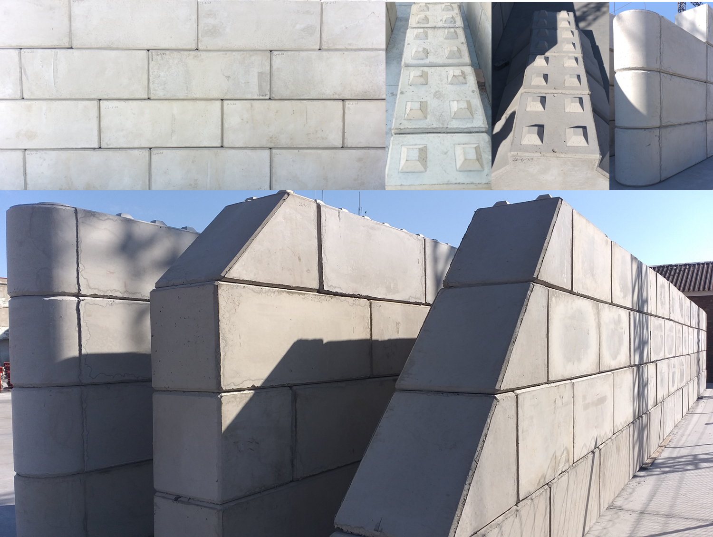
BLOCK MOULDS

Slide 4
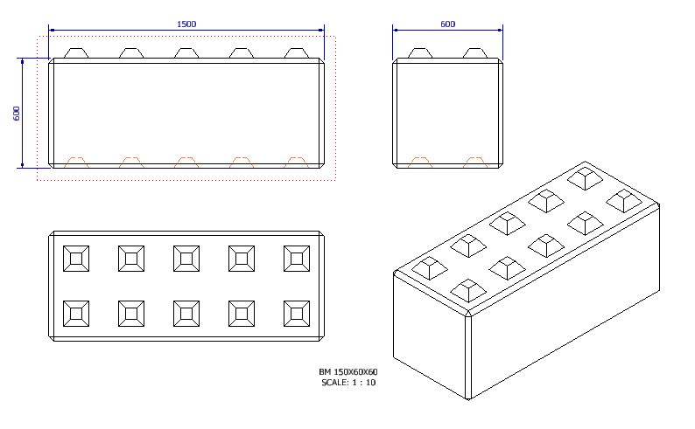
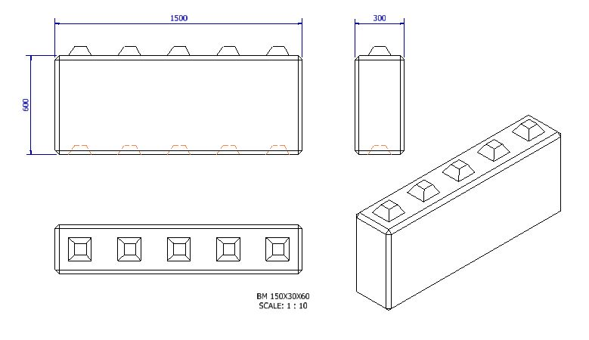
CONCRETE BLOCK SIZES AND PRICING
Wall Block 600mm 1.5 x .600 x .600 Volume: 0.540m³ | R 2,610.69
Wall Block 300mm 1.5 x .300 x .600 Volume: 0.270m³ | R 2,289.47

Slide 5
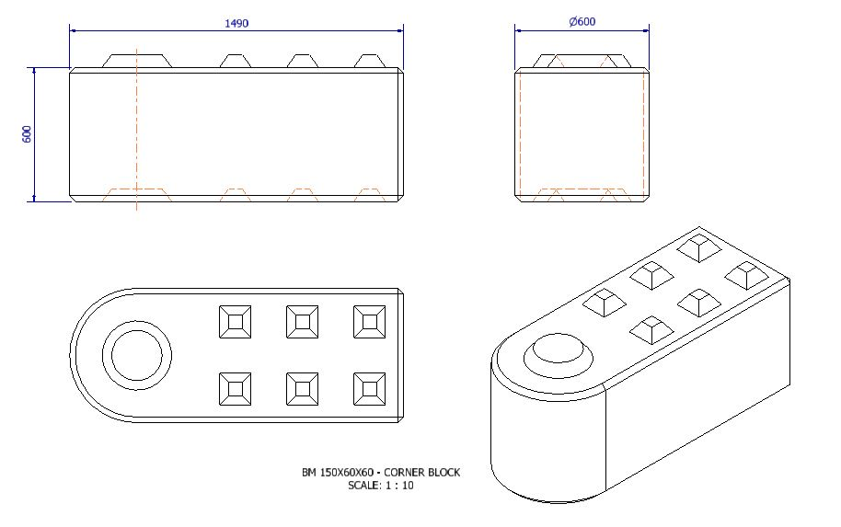
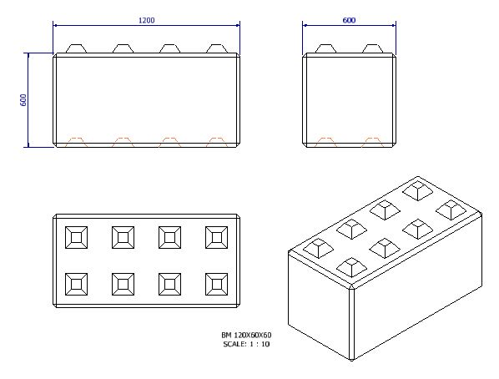
CONCRETE BLOCK SIZES AND PRICING
Round, Corner Block. 1.5 x .600 x .600 Volume: 0.540m³ | R 2,610.69
4 Cup Block 600mm 1.2 x .600 x .600 Volume: 0.432m³ | R 2 510.69

Slide 6
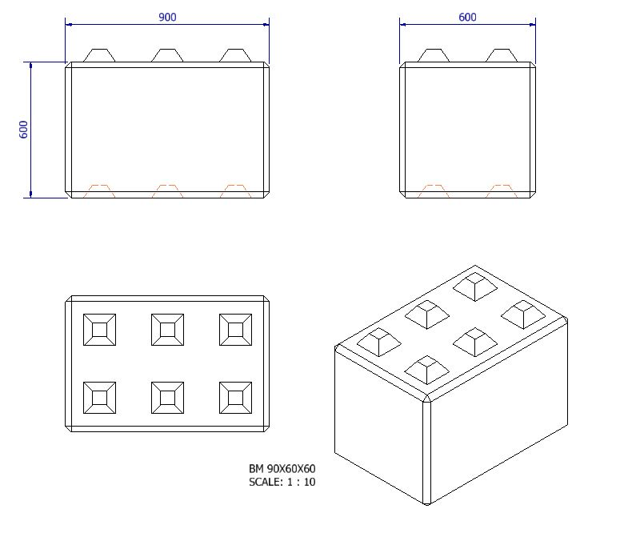
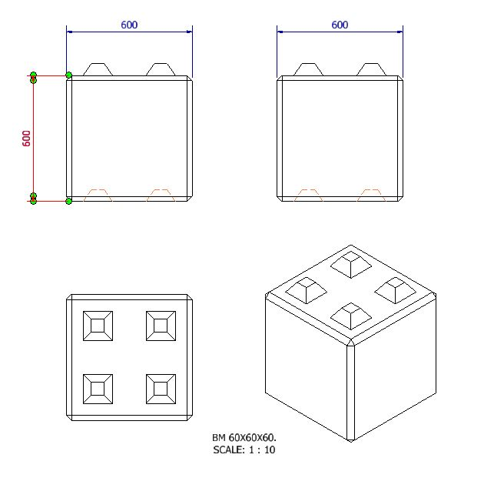
CONCRETE BLOCK SIZES AND PRICING
3 Cup Block 600mm .900 x .600 x .600 Volume: 0.324m³ | R 2 389.47
Half Block 600mm .600 x .600 x .600 Volume: 0.216m³ | R 2 210.69

Slide 7
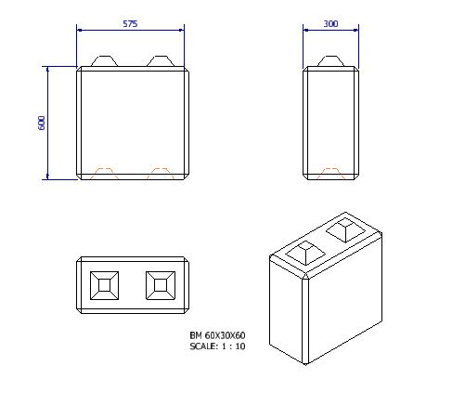
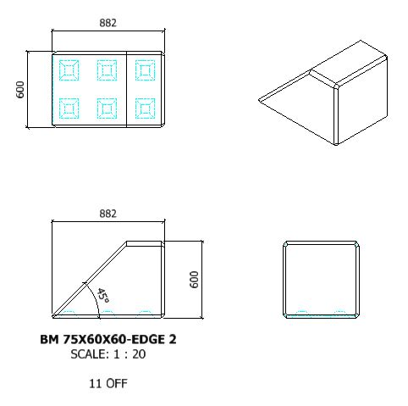
CONCRETE BLOCK SIZES AND PRICING
Half Block 300mm 0.600 x .300 x .600 Volume: 0.324m³ | R 1,594.39
Edge Block 882mm 0.882 x .600 x .600. Volume: 0.432m³ | R 1,776.25

Slide 8
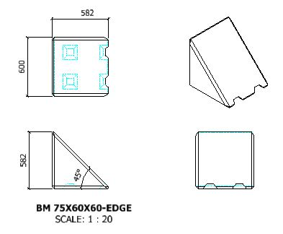
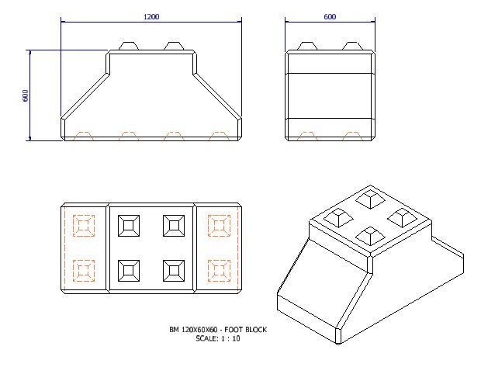
CONCRETE BLOCK SIZES AND PRICING
Edge Block 750mm .750 x .5 x .600 x .600. Volume: 0.216m³ | R 1,644.39
Footing, Foundation Block 1.200 x .600 x .600 Volume: 0.432m³ | R 2,610.69

Slide 9
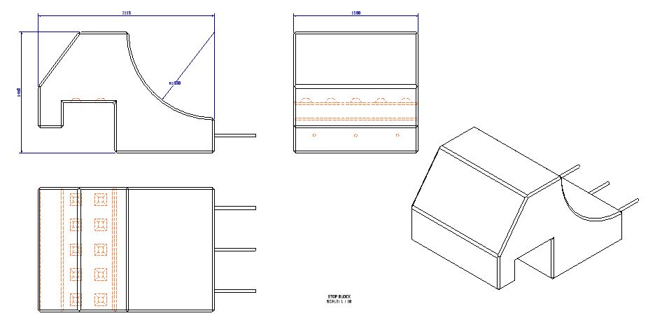
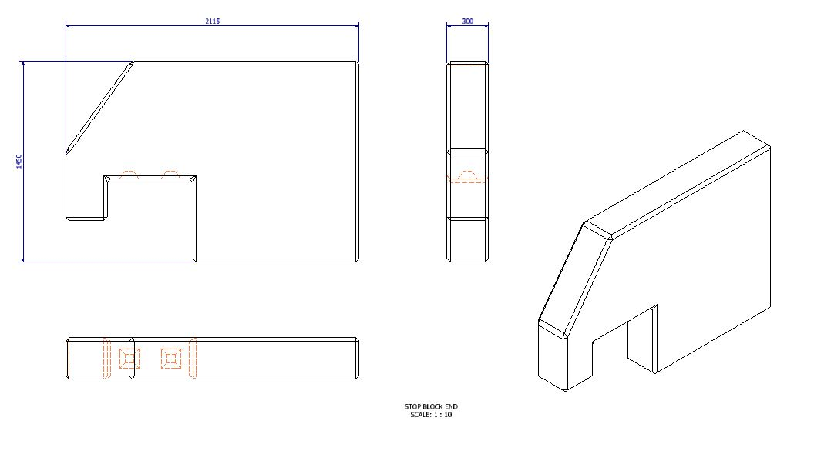
CONCRETE BLOCK SIZES AND PRICING
Stop Block 1.150 x 1.800 x 1.5 Volume: 3.105m³ | R 3,157.48
Stop Block End 2.10 x 1.45 x .300 Volume: 0.914m³ | R 2,875.23

